Slide 1
Relation between Magist and the e-commerce market in Brazil
statistical insight of magist’s influence in the high tech e-commerce sector

Slide 2
Exploring Brazil's
e-commerce potential for Eniac & Partnership with Magist
Why Eniac would benefit from entering the Brazilian
e-commerce Market with or without partnering Magist

Slide 3
Brazilian Market Overview
brazilian e-commerce market
more than 20bn
revenue this year
expects
where electronics and high tech
products sum up
of whole revenue share
28% +

Slide 4
Insight of e-commerce development
e-commerce total revenue
increases by more than
up to approx until 2027
250%
80bn
whereas electronic and high tech products have estimated revenue change of
per year
30 - 35 %

Slide 5
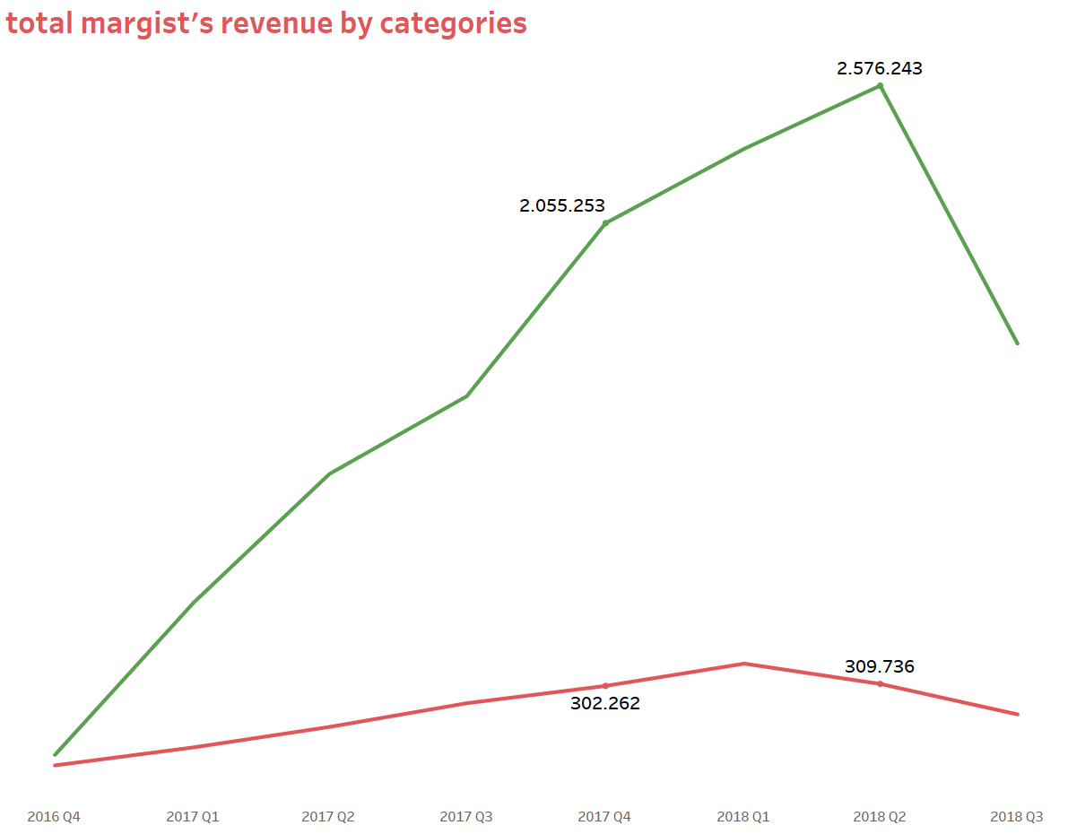

Slide 6
Some more numbers
12.5 days
the average order fulfillment time from the date of purchase to the successful delivery of the product to the customer
148$
average tech seller income on
Magist per month

Slide 7
Recommendations
Expansion into the Brazilian Market:
We highly recommend that Eniac consider expanding its operations into the thriving Brazilian ecommerce market.
Rapidly growing e-commerce sector
high demand for high tech and electronics, especially smartphones
Early market
Partnership with Magist:
We highly recommend that Eniac do not partner with Magist when expanding into the Brazilian ecommerce market.
Long delivery time (lack of warehouses for tech products)
Insignificant impact on market
Limited scale of sellers
Substantially lower total revenue than Eniacs revenue just last year

Slide 8
Sources and contact
contact information:
jodie@wbs-coding.com
chris@wbs-coding.com
sources:
Magist’s DB
statista.com
Mordor Intelligence
E-commerce Next
eMarketer
some random
business address
here
and here

Slide 9
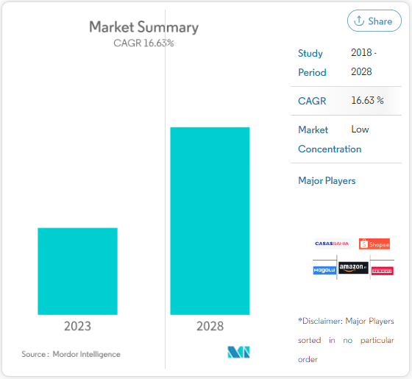
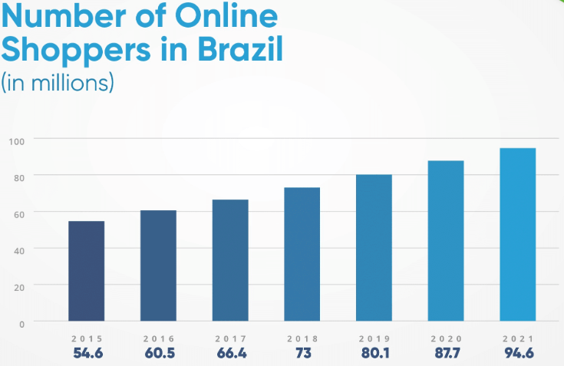
Appendix
Source: Ecommerce Next
Source: Mordor Intelligence

Slide 10
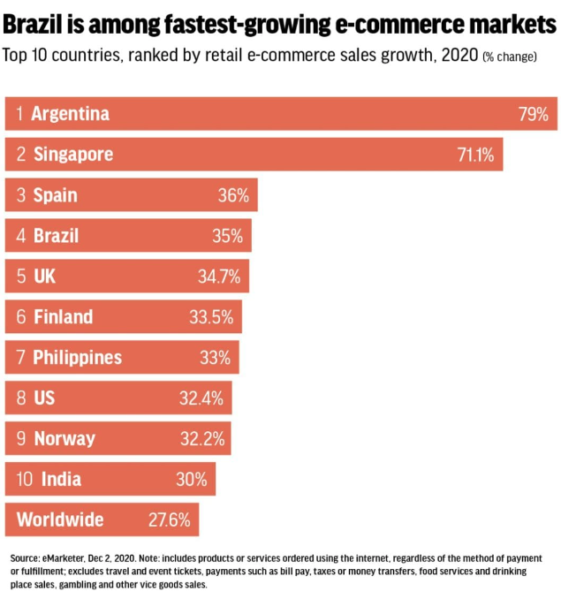
Appendix
Source: eMarketer

